Slide 1
Disease Prediction using Machine Learning
Ayush Pundir Mentored By-
2018748 Dr. Sharon Christa
E(13)

Slide 2
Problem Statement
The dependency on computer-based technology has resulted in storage of lot of electronic data in the health care industry. As a result of which, health professionals and doctors are dealing with demanding situations to research signs and symptoms correctly and perceive illnesses at an early stage. However, Machine Learning technology have been proven beneficial in giving an immeasurable platform in the medical field so that health care issues can be resolved effortlessly and expeditiously. Disease Prediction is a Machine Learning based system which primarily works according to the symptoms given by a user. The disease is predicted using algorithms and comparison of the datasets with the symptoms provided by the user..

Slide 3
Methodology
Data Preprocessing-
This is the very first step while making any machine learning model.
● Firstly, the Data is collected.
● Then the data is checked for any missing value, if the missing value is found then it is taken care of.
● After that the data is divided into training and testing sets.

Slide 4
Model Building-
Two of the many classification techniques are used to make this model. They are-
1) Naïve Bayes Classification.
2) Decision Tree Classification.

Slide 5

Naïve Bayes
● Works on the Bayes Theorem.
● One of the simplest and most effective classifier.

Slide 6
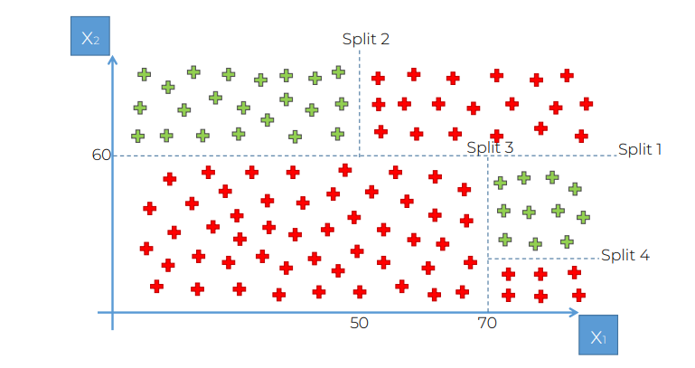
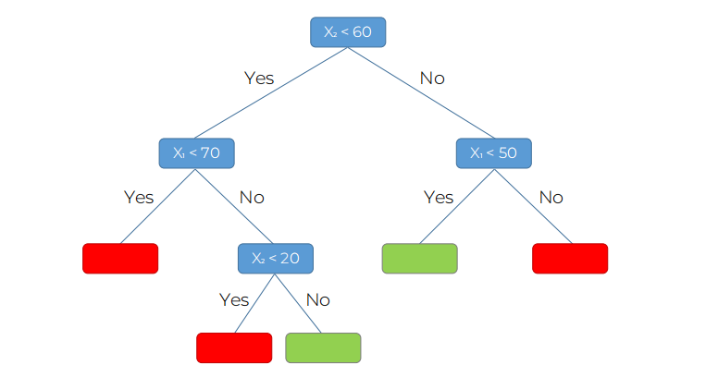
Decision Tree
● It is a tree Structured Classifier.
● In a Decision tree, there are two nodes, which are the Decision Node and Leaf Node.

Slide 7
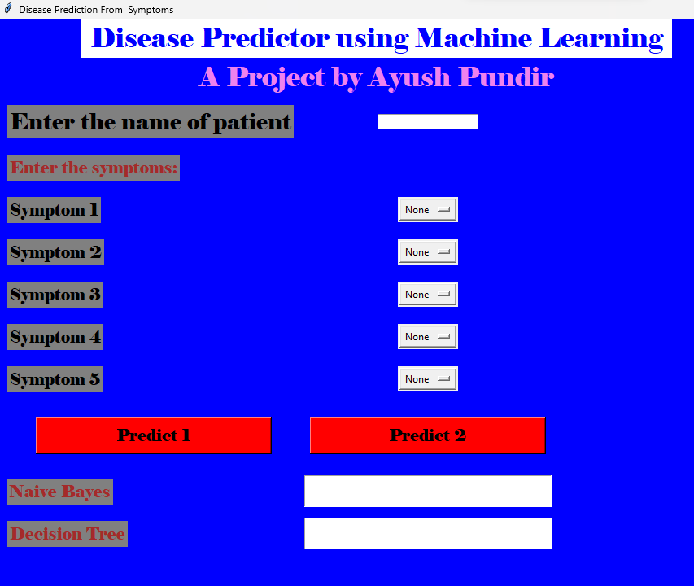
Result
MODEL | ACCURACY
Naïve Bayes | 0.9878
Decision Tree | 0.9761

Slide 8
Conclusion and Future Work
The aim of this project is to predict disease based on symptoms. The project is set up in such a way that the device takes the user's symptoms as input and generates an output, which is disease prediction. A prediction accuracy probability of 0.9761 is obtained by the Decision Tree model and 0.9878 by the Naïve Bayes model on an average.
There are several areas of research in the field of using machine learning to predict disease.
● Predictive Modeling of Disease Risk Factors: Researchers use machine learning algorithms to identify patterns and correlations between demographic, genetic and lifestyle factors and the risk of specific diseases.
● Electronic Medical Record Analytics: Uses machine learning to analyze large datasets of electronic medical records to identify patterns and predict patient outcomes.

Slide 9


